Slide 1


Amanda Chapman
30th March 2026
Data Science Capstone

Slide 2

Outline
Executive Summary
Introduction
Methodology
Results
Conclusion
Appendix

Slide 3
Executive Summary
Summary of Methodologies
Data collection from SpaceX API web scraping Wikipedia
Data wrangling
Exploratory data analysis with visualisations and SQL
Interactive visualisations with Folium and Plotly Dash
Predictive analysis with Machine Learning Classification Models
Summary of Results
Production of csv files for use in further project work
Wrangling of initial csv file to obtain landing outcomes for launch sites
Exploratory data analysis of variables having an effect on landing outcomes
Screenshots of EDA visualisations and interactive dash application
Machine learning predictions to find the best model for landing predictions

Slide 4
Introduction
Project background and context
SpaceX is one of the most successful companies in commercial space flight.
The reason for this competitive edge over competitors, is due to successful landing and reuse of the first stages of rocket launches.
SpaceX is able to advertise rocket launches costing 62 million dollars, with other providers costing upwards of 165 million dollars.
Making effective predictions of whether the first stage can be reused, is essential to continue these huge savings and the competitive edge of SpaceX.
Questions to be answered
Which variables such as booster version, launch site, payload mass, number of flights have the most effect on landing outcomes?
Are there changes to the rate of successful landings within a range of years?
Can we find the best machine learning classification model to predict the landing outcomes as success or failure?
Problems you want to find answers

Slide 5

Section 1

Slide 6
Methodology
Executive Summary
Data collection methodology:
  Collection of data form SpaceX API
  Web scraping of Falcon 9 launch records from Wikipedia
  Perform data wrangling:
Conversion of mission outcomes to a binary value and creation of a class column
  Perform exploratory data analysis (EDA) using visualisation and SQL:
  Use of graphs such bar charts, scatter plots to visualise the data
  SQL queries to find specific information on the variables in the dataset
Perform interactive visual analytics using Folium and Plotly Dash
Creation of geospatial map showing launch site data and proximity to certain features
Creation of a Dash interactive application with drop downs, pie charts and yearly scatter plots
Perform predictive analysis using classification models
  Data was split into training and testing sets for use in classification modeling
  The best model was determined from grid search cross validation and accuracy metrics

Slide 7
Data Collection
Data was collected from two sources:-
Request for data from SpaceX API
Scraping of Wiki page showing Falcon 9 and Heavy Launches for SpaceX
After collection of the data DataFrame were created then loaded into CSV files.
The columns obtained from SpaceX API request:-
Flight Number, Date, BoosterVersion, PayloadMass, Orbit, LaunchSite, Outcome, Flights, GridFins, Reused, Legs, LandingPad, Block, ReusedCount, Serial, Longitude, Latitude
The columns obtained from Web Scraping the Wiki page:-
Flight No., Launch site, Payload, Payload mass, Orbit, Customer, Launch outcome, Version Booster, Booster landing, Date, Time

Slide 8
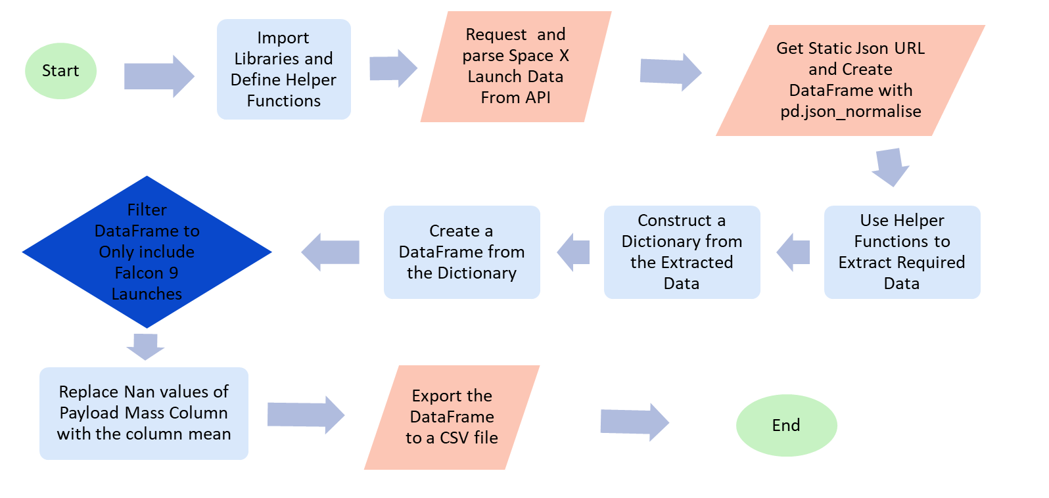
Data Collection – SpaceX API Flow Chart
IBM-Data-Science-Capstone/SpacexX- Lab1 Collecting the Data with API.ipynb at main · Marsbars65/IBM-Data-Science-Capstone

Slide 9
Data Collection – Web Scraping Flowchart
Start
Import Libraries and Define Helper Functions
Request Wiki page List of Falcon 9 and Falcon Heavy Launches
Export the DataFrame to a CSV file
End
Create a Beautiful Soup Object with html. Parser and Extract all Column Names
Construct a Dictionary from the Extracted Data
Create a DataFrame from the Dictionary
Create a DataFrame by Parsing the Launch HTML Table
IBM-Data-Science-Capstone/SpaceX - Collecting the data with webscraping.ipynb at main · Marsbars65/IBM-Data-Science-Capstone

Slide 10
Data Wrangling
The main purpose of the data wrangling process was to extract information on launch sites, and perform some Exploratory Data Analysis (EDA) to find some patterns in the data and determine what would be the label for training supervised models.
Of particular importance was to uncover the landing outcomes for each launch site.
Outcomes were converted to a binary classification of 0 for failure and 1 for success.
A new column called “Class” was added to the DataFrame for the binary data.

Slide 11
Data Wrangling Flowchart
Start
Import Libraries and Define Auxiliary Functions
Load CSV file from SpaceX from API Dataset
Identify and Calculate Percentage of Missing Values in Each Attribute
Calculate the number of launches on each site
Identify Numerical and Categorical Values
Calculate the number and occurrence of each orbit
Calculate the Number and occurrence of mission outcomes
Create a landing outcome column
End
Export the DataFrame to CSV file
IBM-Data-Science-Capstone/SpaceX - Lab 2 Data Wrangling.ipynb at main · Marsbars65/IBM-Data-Science-Capstone

Slide 12
EDA with Data Visualization
Summary of the charts plotted for EDA visualisation
Scatter plots were used to visualise:-
Flight number versus payload mass(kg), launch site and orbit
Payload mass(kg) versus launch site and orbit
A bar chart was used to visualise:-
The success rate for each orbit type
A line chart was used to visualise:-
The success rate over a range of years from 2010 to 2020
Scatter plots were used to show the relationship between two variables.
A bar chart was chosen for the categorical variable orbit type to show comparisons of success rate.
A line chart was chosen for the time series as this provided the best visualisation over time.
IBM-Data-Science-Capstone/Spacex - EDA with Visualisation (2).ipynb at main · Marsbars65/IBM-Data-Science-Capstone

Slide 13
EDA with SQL
Summary of SQL queries in EDA with SQL
SQL queries were used to query the launch record DataFrame as follows:-
Firstly, all columns for the DataFrame were selected
Displayed distinct launch sites for SpaceX rockets
Displayed 5 records where the launch site began with letters CCA
Displayed the total payload mass carried by boosters launched by NASA (CRS)
Displayed the average payload mass carried by booster version F9 v1.1
Listed the date when the first successful landing in ground pad was achieved
Listed the names of boosters which have success in drone ship and have payload mass greater than 4000 but less than 6000
Listed the total number of successful and failure missions
Listed all the booster_versions that have carried the maximum payload mass, using a subquery with a suitable aggregate function
Listed the records which will display the month names, failure landing_outcomes in drone ship, booster versions, launch_site for the months in year 2015.
Ranked the count of landing outcomes (such as Failure (drone ship) or Success (ground pad)) between the date 2010-06-04 and 2017-03-20, in descending order.
IBM-Data-Science-Capstone/SpaceX - EDA with SQL.ipynb at main · Marsbars65/IBM-Data-Science-Capstone

Slide 14
Build an Interactive Map with Folium
Summary of map objects such as markers, circles, lines, etc. created and added to a folium map
A folium map was created with the centre location as NASA Johnson Space Centre at Houston, Texas.
Circle objects were added for each launch site with an additional pop-up label showing launch site names
Marker clusters were added to show the launch outcomes for each launch site. Green markers and red markers were allocated to successful and unsuccessful launches respectively
A mouse position was added to the map which automatically returned latitude and longitude on scrolling through the map
Markers were added for the closest coastlines, railways, highways and cities with distances from launch sites being shown with polylines
By adding markers, marker clusters, pop up labels and lines the map became much easier to read. Without the above there would have been no clear indication of where the launch sites are, the launch outcomes or the proximity to coastlines, railway lines etc.
IBM-Data-Science-Capstone/Spacex - Interactive Visual Analytics with Folium (2).ipynb at main · Marsbars65/IBM-Data-Science-Capstone

Slide 15
Build a Dashboard with Plotly Dash
Summary of plots/graphs and interactions added to a dashboard
A dropdown list to enable selection of all sites or specific launch sites was added
Pie charts were added to show the success and failure rates for all sites or for specific sites
A slider was added to enable selection of payload mass ranges
Scatter graphs were added to show the correlation of payload mass and class of outcome for different booster versions
Adding dropdown lists, visualisations and a slider has allowed for user friendliness of the dashboard.
IBM-Data-Science-Capstone/SpaceX - Launch Records Dashboard (2).ipynb at main · Marsbars65/IBM-Data-Science-Capstone

Slide 16
Predictive Analysis (Classification) - Flowchart
Start
Create numpy array from class column in data
Standardise data and assign to the variable X using fit_transform
Split the data using into training and test sets using train_test_split
Calculate the accuracy of each model on the test data using the method score
Create a grid search object for each of the models to find the best parameters
Create logistic regression, SVC, decision tree and KNN models
Plot the confusion matrices for each of the models
Determine the best model by comparing the accuracy scores and confusion matrices of the models
End
IBM-Data-Science-Capstone/SpaceX_Machine Learning Prediction_Part_5 (3).ipynb at main · Marsbars65/IBM-Data-Science-Capstone

Slide 17
Results
Exploratory data analysis results
Interactive analytics demo in screenshots
Predictive analysis results

Slide 18

Section 2

Slide 19
EDA with Visualisation

Slide 20
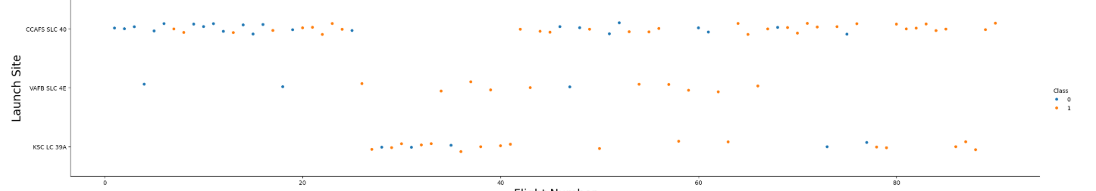
Flight Number vs. Launch Site
Scatter plot of Flight Number vs. Launch Site
The majority of flights came from CCAFS SLC 40 launch site. The least number of flights was from VAFB SLC 4E.
The number of successes appears to outnumber the number of failures for each launch site.
The earliest flights were all unsuccessful
The highest success rate is from the VAFB SLC 4E launch site, however there are less flights
The latest flights have 100% success rate

Slide 21
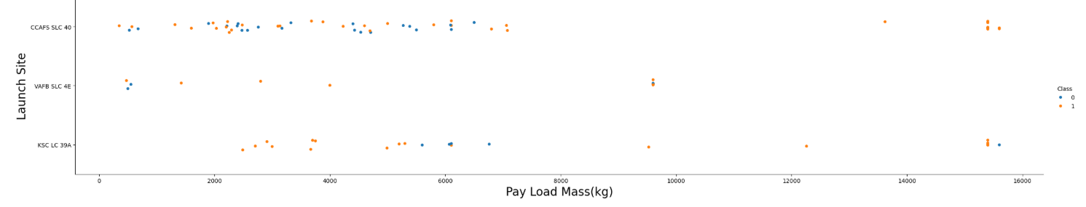
Payload vs. Launch Site
Scatter plot of Payload vs. Launch Site
No rockets were launched with a higher payload mass than 10000 from the VAFB-SLC launch site
At payloads higher than approximately 7000kg all launches were successful for the CCAFS_SLC launch site
Most of the launches with a higher payload than 7000kg were successful
The KSC LC launch site has the greatest success at lower payloads up to 6000kg

Slide 22
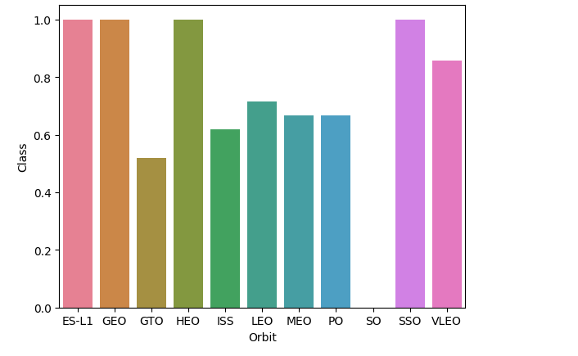
Success Rate vs. Orbit Type
Bar chart for the success rate of each orbit type
Orbits ES-LI, GEO, HEO and SSO had 100% success rate
Orbit SO had 0% success
Orbits GTO, ISS, LEO, MEO, PO and VLEO had success rates between 50% and 90%

Slide 23
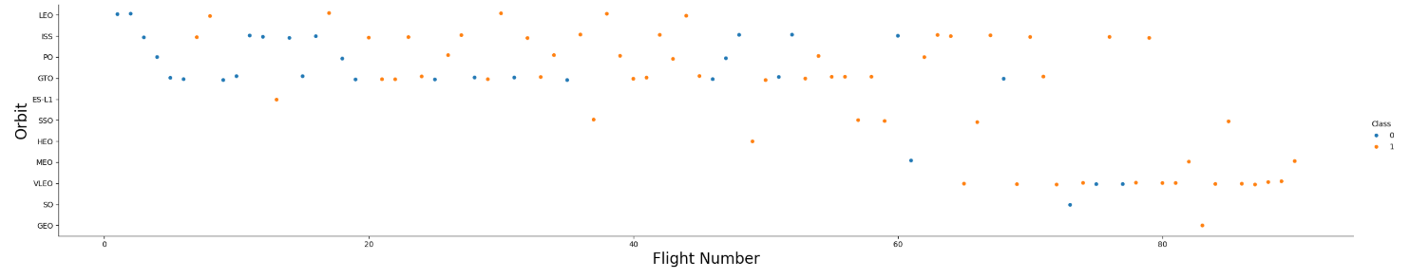
Flight Number vs. Orbit Type
Scatter plot of Flight number vs. Orbit type
The later flights in the LEO orbit are all successful therefore there does appear to be a correlation
GTO orbit and number of flights appear to have no or very little correlation

Slide 24
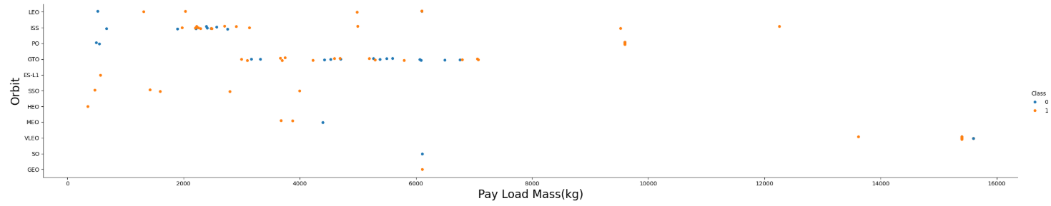
Payload vs. Orbit Type
Scatter point of payload vs. orbit type
For LEO, ISS and Polar orbits successful landing rate is greater for heavier payloads
GTO shows a very mixed successful/failed landing rate and does not appear to be correlated with payload mass

Slide 25
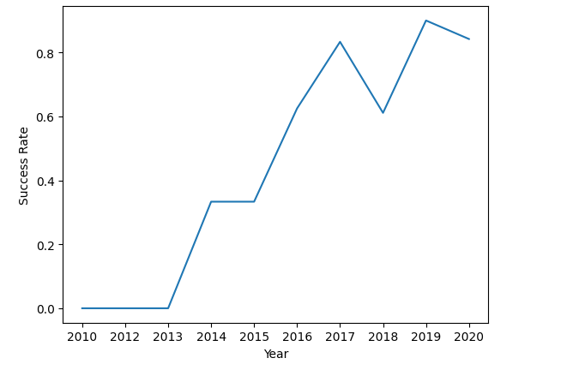
Launch Success Yearly Trend
Line chart of yearly average success rate
Since 2013 there has been an increase in the success rate
Success rate stabilised from 2014 to 2015 than started to increase
There was a sharp decrease from 2017 to 2018 and another slight decrease from 2019 to 2020

Slide 26
EDA with SQL

Slide 27

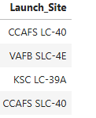
All Launch Site Names
Explanation
The SQL query selected launch sites starting with CCA from spacextable DataFrame and displayed them.

Slide 28

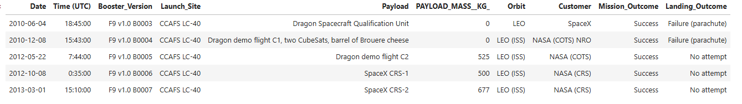
Launch Site Names Begin with 'CCA'
Result
Explanation
The SQL query selected launch sites starting with CCA from spacextable DataFrame and displayed them.

Slide 29

Total Payload Mass
Explanation
The query returned the total payload mass only for NASA (CRS) entries in the customer column of the spacextable DataFrame.

Slide 30

Average Payload Mass by F9 v1.1
Explanation
The query averaged the payload mass only for booster version F9 v1.1 in the booster version column of the spacextable DataFrame.

Slide 31


First Successful Ground Landing Date
Explanation
The query selected the minimum date or very first date from the landing outcome column where success was on ground pad.

Slide 32

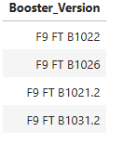
Successful Drone Ship Landing with Payload between 4000 and 6000
Explanation
The query selected the landing outcome success (drone ship) then limited the result to payload masses between 4000kg and 6000kg.

Slide 33
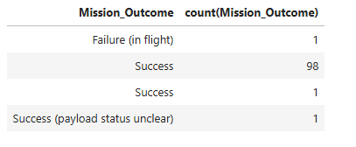
Total Number of Successful and Failure Mission Outcomes
Explanation
The query counted the distinct mission outcomes from the spacextable DataFrame then grouped by mission outcome.

Slide 34

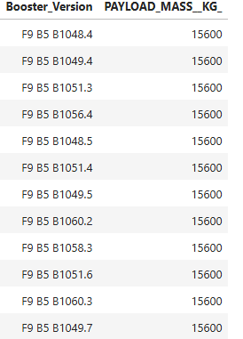
Boosters Carried Maximum Payload
Explanation
The query used a subquery and the aggregate function select max to find the booster versions that carried the maximum payload.

Slide 35
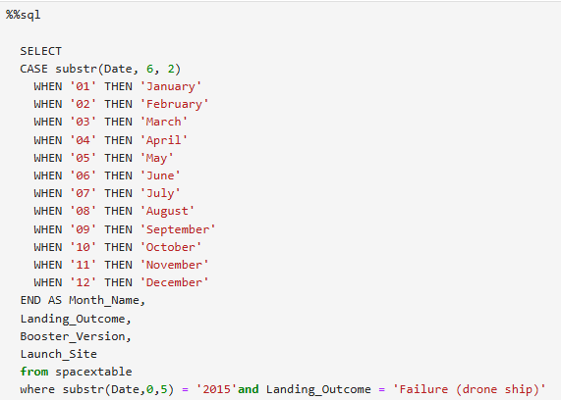

2015 Launch Records
Explanation
The query listed the failed landing outcomes in drone ship, months, booster versions and launch sites for the year 2015.

Slide 36
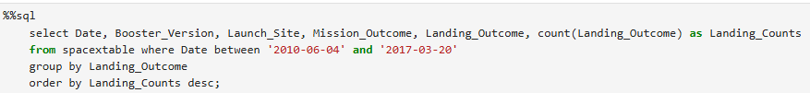
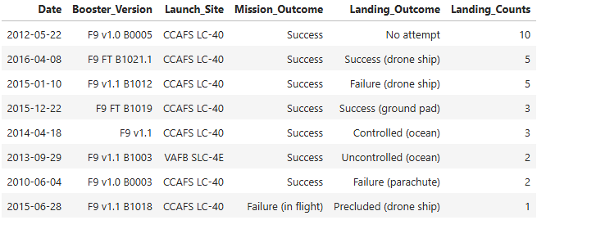
Rank Landing Outcomes Between 2010-06-04 and 2017-03-20
Explanation
Landing outcomes ranked by landing counts between 4th of June 2010 and 20th of March 2017.

Slide 37

Section 3

Slide 38
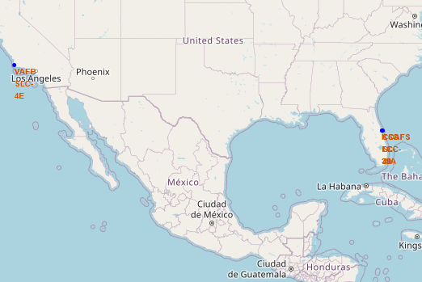
All launch sites’ location markers on a global map
Explanation
All launch sites are close to a coastline. This is for safety as rockets can be launched seaward to ensure falling debris does not land near any populations of people
All launch sites are near the equator which takes advantage of the Earth’s rotational speed, thereby providing extra velocity boost which reduces fuel consumption and allows more efficient access to various orbital inclinations (ref: Microsoft Copilot Search)

Slide 39
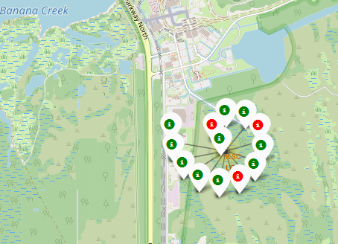
Colour-labeled launch outcomes on the map
Explanation
Colour markers allow for easy identification of launch sites with high success rates as follows:-
Green Marker = Successful Launch
Red Marker = Failed Launch
The KSC LC-39A has a high success rate as shown in the screenshot opposite with 10 out of 13 launches being successful

Slide 40
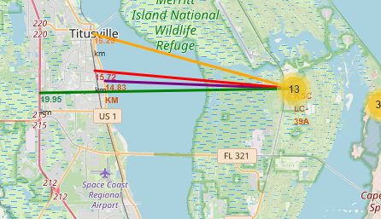
Distances to proximities from KSC-LC-39A Launch Site
Explanation
Distances from the KSC-LC-39A launch site to proximities are:-
Railway line 15.72km
Coastline 14.83km
Highway 19.95km
City(Titusville) 16.25km
The above are quite close to the launch site.
The distance to the nearest city is of particular note. This could be potentially dangerous if there was falling debris from a rocket launch.

Slide 41

Section 4

Slide 42
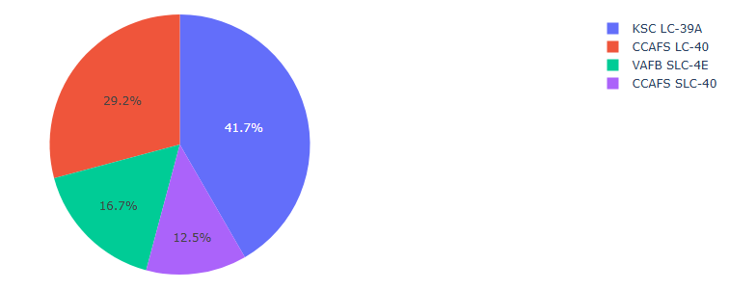
Total Successful Launches by Site
Explanation
From the pie chart and the key opposite it can be seen that the launch site with the highest success rate is the KSC-LC-39A launch site with a rate of 41.7%. Only 8.3% less than half of all launches.

Slide 43
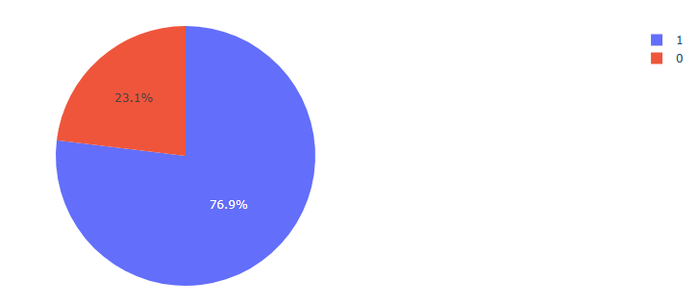
Total Success/Failure Rate for Launch Site KSC-LC-39A
Explanation
The success rate of rocket launches at KSC-LC-39A launch site is 76.9% as opposed to a failure rate of 23.1%.
Also, the folium map showed that 10 out of 13 landings were successful.

Slide 44
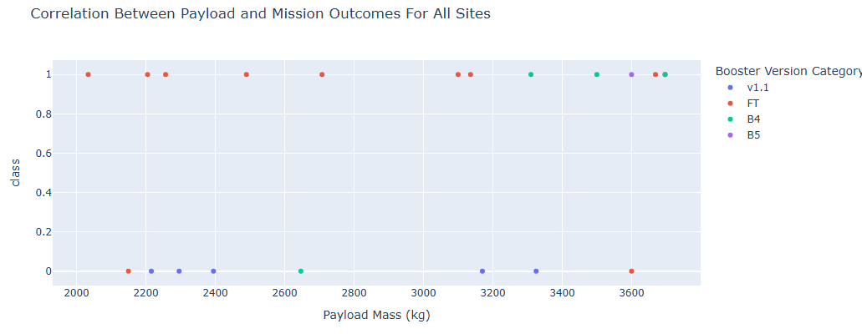
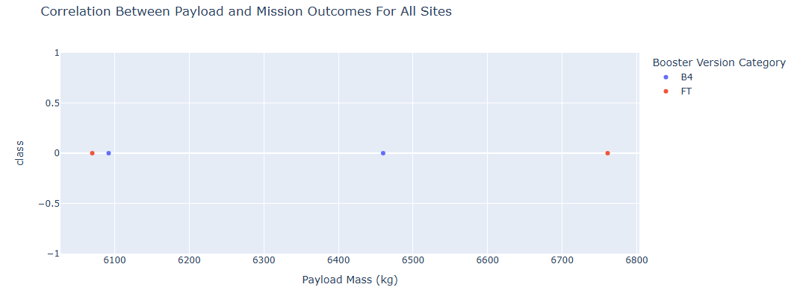
Payload Mass vs. Launch Outcome for all sites
Explanation
Payload masses between 2000kg and 4000kg have a greater success rate.
Heavier payloads between 6000kg and 8000kg had no successful landings as can be seen from the plot on the right.
Booster version FT has the highest success rate as can be seen from the plot on the left.
There is one out of one successful rocket launch for the B5 rocket, however this would not provide a fair comparison for the other booster versions.

Slide 45

Section 5

Slide 46
Classification Accuracy
The built model accuracy for all built classification models is shown below:-
The model with the highest classification accuracy is the Decision Tree model with an accuracy of 0.89 versus an accuracy of 0.83 for the other models.
For three of the models the classification report metrics are the same which is due to the small sample size.
*The classification reports for the models are shown in Appendix A
Model | Precision | Recall | F1 Score | Accuracy
Logistic Regression | 0.80 | 1.00 | 0.89 | 0.83
Support Vector | 0.80 | 1.00 | 0.89 | 0.83
Decision Tree | 0.92 | 0.92 | 0.92 | 0.89
K Nearest Neighbour | 0.80 | 1.00 | 0.89 | 0.83

Slide 47
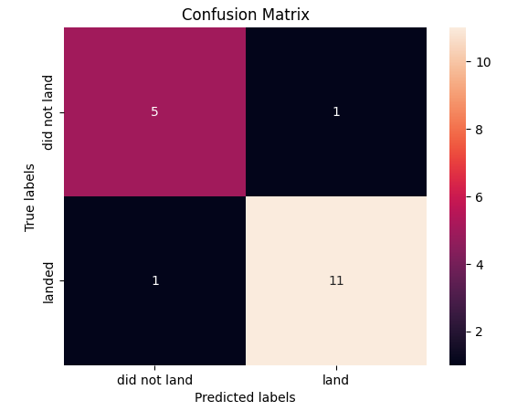
Confusion Matrix
The confusion matrix for the Decision Tree
model is shown opposite.
Explanation
The confusion matrix represents the following:-
True Positive 11
True Negative 5
False Positive 1
False Negative 1
16 out of 18 landing outcomes were predicted accurately.
*See Appendix B for confusion matrix of other models

Slide 48
Conclusions
The KSC-LC-39A has the highest success rate of landing outcomes compared to other launch sites.
There is an upwards trend in yearly success rates with a dip between 2017 to 2018 perhaps due to significant operational challenges(ref Microsoft co-pilot). There was another dip between 2019 to 2020 perhaps due to covid-19.
Lower payload mass results in a higher rate of launch successes than high payload mass.
Launch sites are in close proximity to a railway line, highway, coastline or city.
All launch sites are close to the equator to take advantage of the higher rotational speed of the Earth.
The best model for predicting landing outcomes is the Decision Tree Model.
Orbits ES-LI, GEO, HEO and SSO had 100% success rate.

Slide 49
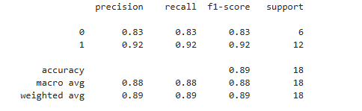
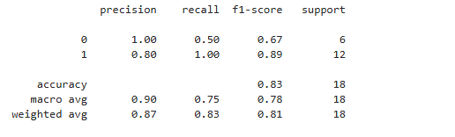
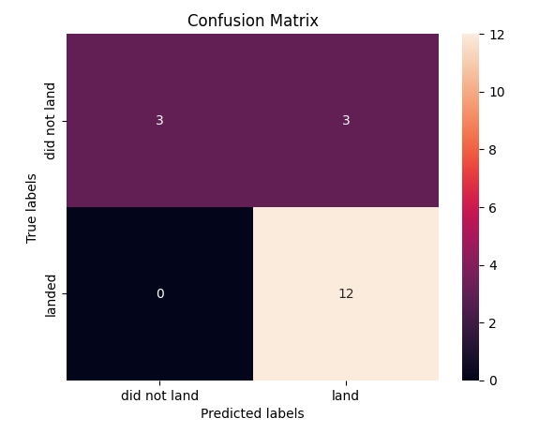
Appendix
Appendix A
Appendix B
Decision Tree Model
SVC, KNN and Logistic Regression Models

Slide 50


